Slide 1
Image Analysis

Slide 2
Image Enhancement Image Restoration
Image Analysis

Slide 3
What Is Image Enhancement?
Image enhancement is the process of making images more useful
The reasons for doing this include:
Highlighting interesting detail in images
Making images more visually appealing

Slide 4
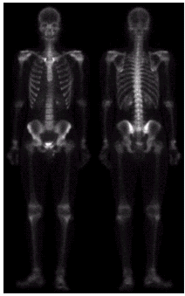
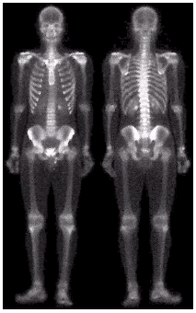
Image Enhancement Examples (cont…)

Slide 5
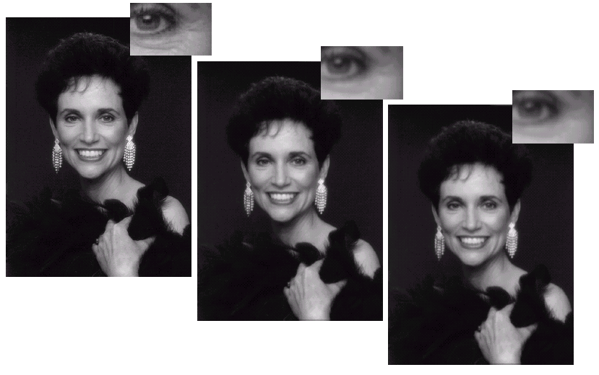
Image Enhancement Examples (cont…)

Slide 6
Spatial & Frequency Domains
There are two broad categories of image enhancement techniques
Spatial domain techniques
Direct manipulation of image pixels
Frequency domain techniques
Manipulation of Fourier transform or wavelet transform of an image

Slide 7
Enhancement
Techniques
Spatial Domain
Operates on Pixels
Frequency Domain
Operates on Frequency Transform of
Image

Slide 8
Special domain
Special domain methods includes:-
Point processing
Neighbourhood processing

Slide 9
Special domain
Point processing is of two types
Gray level transformation/point operation:-
Image negative/Digital negative,
Log transformations,
Power law transformation.
2) Piecewise linear transformation.
Contrast Streching
Thresholding
Bit plane Slicing(Bit Extraction)
Gray level slicing(Intensity Slicing)

Slide 10
A Note About Grey Levels
So far when we have spoken about image grey level values we have said they are in the range [0, 255]
Where 0 is black and 255 is white
There is no reason why we have to use this range
The range [0,255] stems from display technologes
For many of the image processing operations in this lecture grey levels are assumed to be given in the range [0.0, 1.0]

Slide 11
Basic Spatial Domain Image Enhancement
Most spatial domain enhancement operations can be reduced to the form
g (x, y) = T[ f (x, y)]
where f (x, y) is the input image, g (x, y) is the processed image and T is some operator defined over some neighbourhood of (x, y)
Origin
x
(x, y)
y
Image f (x, y)

Slide 12
Point Processing
The simplest spatial domain operations occur when the neighbourhood is simply the pixel itself
In this case T is referred to as a grey level transformation function or a point processing operation
Point processing operations take the form
s = T ( r )
where s refers to the processed image pixel value and r refers to the original image pixel value.

Slide 13
Basic Grey Level Transformations
There are many different kinds of grey level transformations
Three of the most common are
Linear
Negative/Identity
Logarithmic
Log/Inverse log

Slide 14
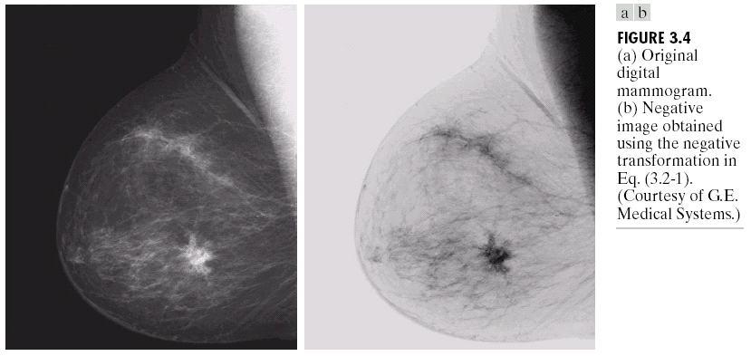
Point Processing Example: Negative Images
Negative images are useful for enhancing white or grey detail embedded in dark regions of an image
Note how much clearer the tissue is in the negative image of the mammogram below
Original Image
s = 1.0 - r
Negative Image

Slide 15
Image Negatives (Negative Transformation)
Example 1:
the following matrix represents the pixels values of an 8-bit image (r) , apply negative transform and find the resulting image pixel values.
Image (r)
solution:
L= 2⁸ = 256
s=L-1-r s =255-r
100 | 110 | 90 | 95
98 | 140 | 145 | 135
89 | 90 | 88 | 85
102 | 105 | 99 | 115
Apply this transform to
each pixel to find the negative
Image (s)
155 | 145 | 165 | 160
157 | 115 | 110 | 120
166 | 165 | 167 | 170
153 | 150 | 156 | 140

Slide 16
Logarithmic Transformations
The general form of the log transformation is
s = c * log(1 + r)
The log transformation maps a narrow range of low input grey level values into a wider range of output values
The inverse log transformation performs the opposite transformation

Slide 17
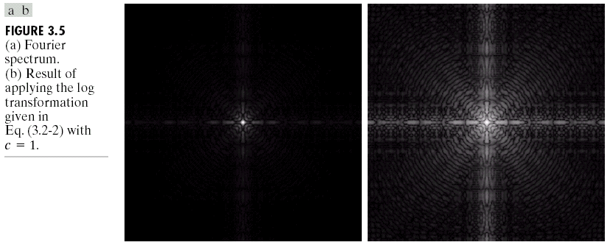
Logarithmic Transformations (cont…)
Log functions are particularly useful when the input grey level values may have an extremely large range of values
In the following example the Fourier transform of an image is put through a log transform to reveal more detail
s = log(1 + r)

Slide 18
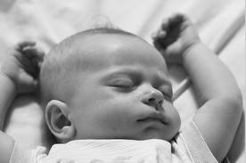

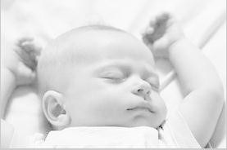
Log Transformations function
Example:
>> g = log(1 + double(f));
>> gs = im2uint8(mat2gray(g));
>> imshow(f), figure, imshow (g), figure, imshow(gs);
f
g
gs

Slide 19
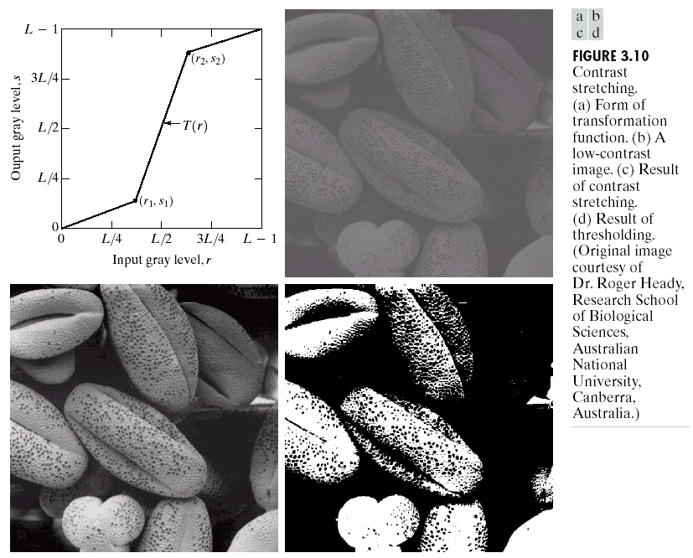
Piecewise Linear Transformation Functions
Rather than using a well defined mathematical function we can use arbitrary user-defined transforms
The images below show a contrast stretching linear transform to add contrast to a poor quality image

Slide 20
Histogram Processing
What is a Histogram?
In Statistics, Histogram is a graphical representation showing a visual impression of the distribution of data.
An Image Histogram is a type of histogram that acts as a graphical representation of the lightness/color distribution in a digital image. It plots the number of pixels for each value.

Slide 21
Histogram?
The histogram of a digital image with gray levels in the range [0, L-1] is a discrete function:
h(r_{k}) = n_{k}
Where:
r_{k} : kth gray level
n_{k} : # of pixels with having gray level r_{k}

Slide 22
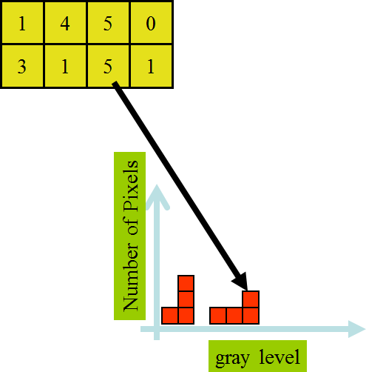
Image Histogram

Slide 23
Image Histograms
The histogram of an image shows us the distribution of grey levels in the image
Massively useful in image processing, especially in segmentation
Frequencies
Grey Levels

Slide 24
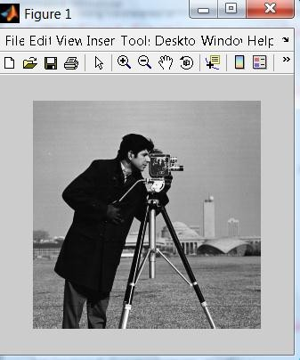
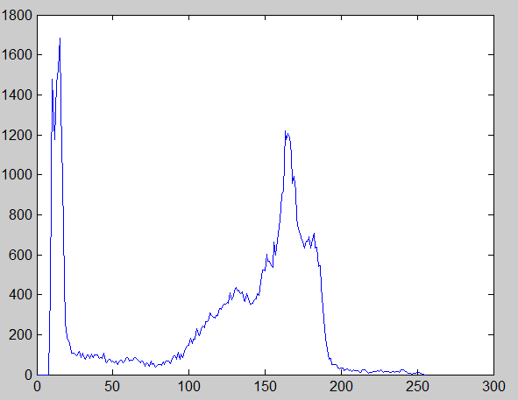
Histogram of the image:
histogram
h(r ) = n
gray levels
k k
Where:
r_{k} : kth gray level
n_{k} : # of pixels with having gray level rk

Slide 25
Histogram of the image:
For example: we have 600 pixels having
the intensity value ≈ 160
24

Slide 26
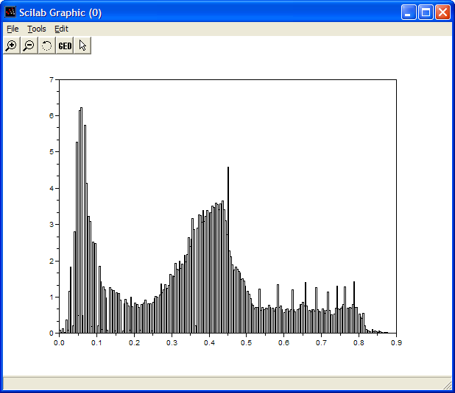
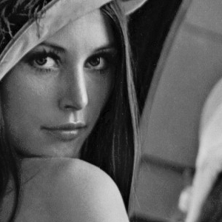
Histogram Examples (cont…)

Slide 27
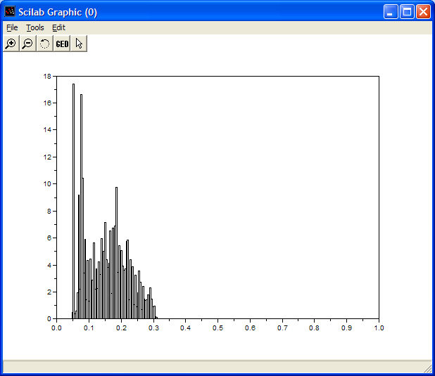
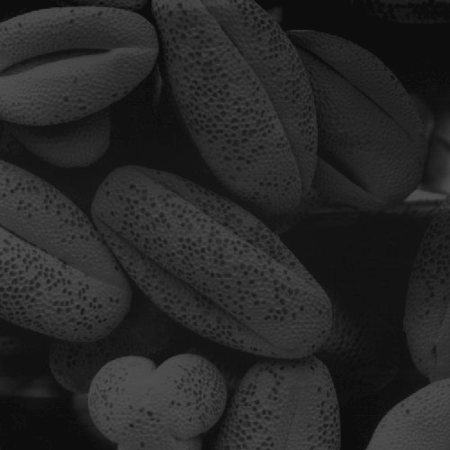
Histogram Examples (cont…)

Slide 28
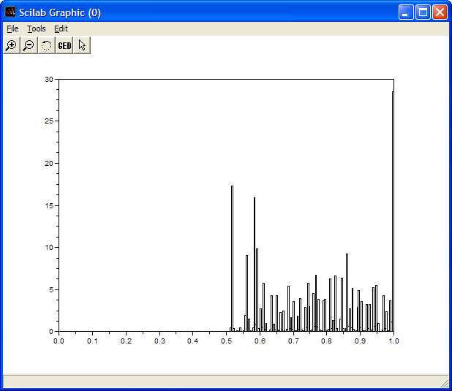
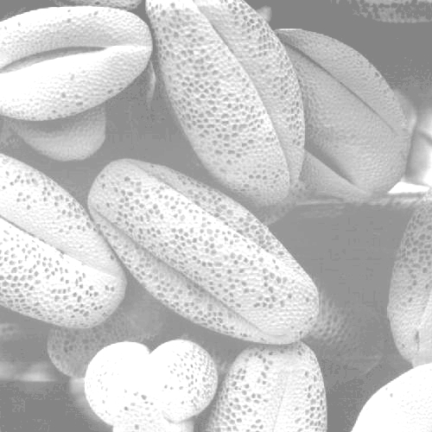
Histogram Examples (cont…)

Slide 29
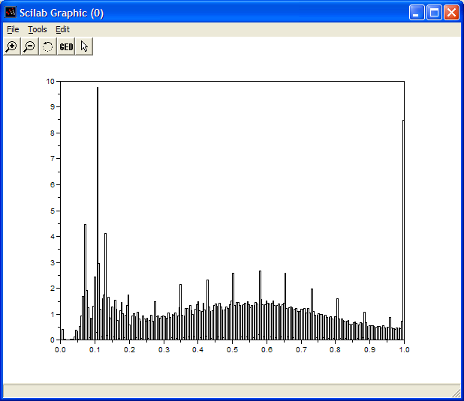
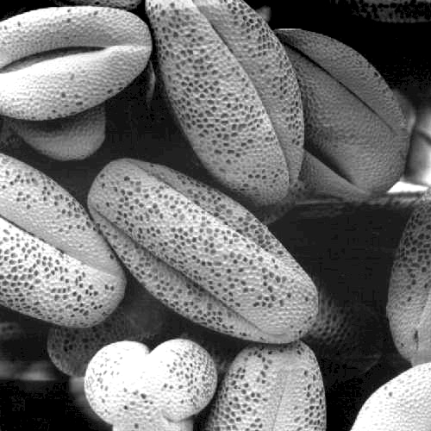
Histogram Examples (cont…)

Slide 30
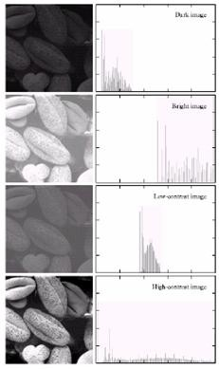
Histogram of the image:
→ low contrast image
→ low contrast image
→ low contrast image
→ high-contrast image
An image whose pixels tend to occupy the entire range of possible gray levels and, in addition, tend to be distributed uniformly, will have an appearance of high contrast and will exhibit a large variety of gray
tones.

Slide 31
Histogram in MATLAB
h = imhist (f, b)
Where f, is the input image, h is the histogram, b is number of bins (tick marks) used in forming the histogram (b = 255 is the default)
A bin, is simply, a subdivision of the intensity scale. For example, if we are working with uint8 images and we let b
= 2, then the intensity scale is subdivided into two ranges: 0 – 127 and 128 – 255. the resulting histograms will have two values: h(1) equals to the number of pixels in the image with values in the interval [0,127], and h(2) equal to the number of pixels with values in the interval [128 255].

Slide 32
Other ways to display Histograms
>> h = imhist(f);
>> bar (h);
>> plot (h);
>> stem (h);

Slide 33
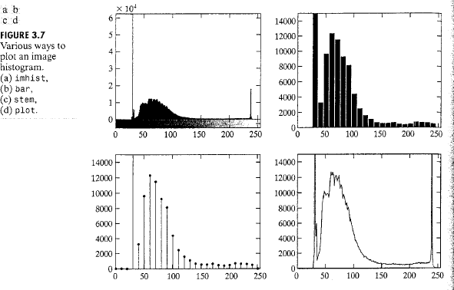
Other ways to display Histograms
Consider an image f. The simplest way to plot its histogram is to use imhist with no output specified:
>> imhist (f);
Figure 3.7(a) shows the result.

Slide 34
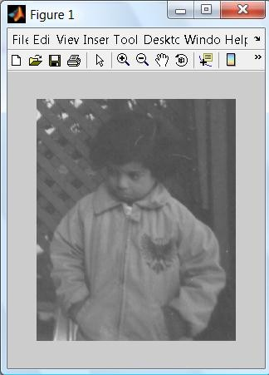
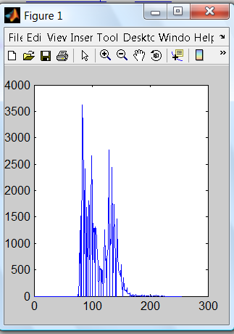
Histogram equalization of the image:
We have this image in matlab called pout.tif, when we plot its histogram it is showed like this:
Notice that the pixels intensity values are concentrated on the middle
(low contrast)

Slide 35
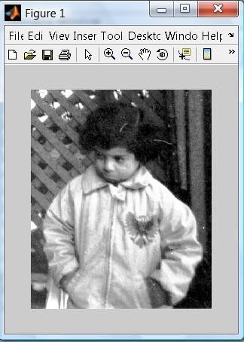
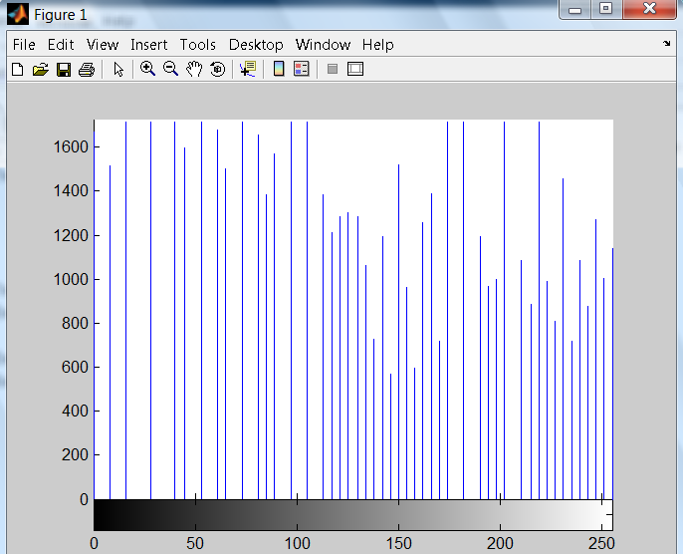
Histogram equalization of the image:
histogram equalization :
is the process of adjusting intensity values of pixels.
The process which increases the dynamic range of the gray level in a law contrast image to cover full range of gray levels.
Im matlab : we use histeq function
Histogram produces pixels having values that are distributed throughout the range

Slide 36
Image Filtering

Slide 37
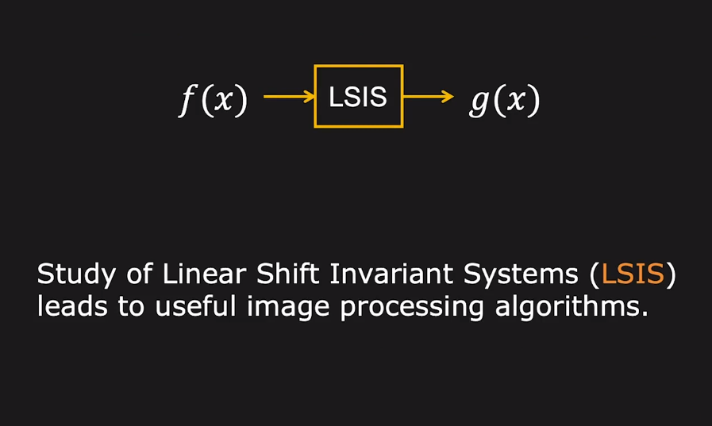
Linear Shift Invariant System

Slide 38
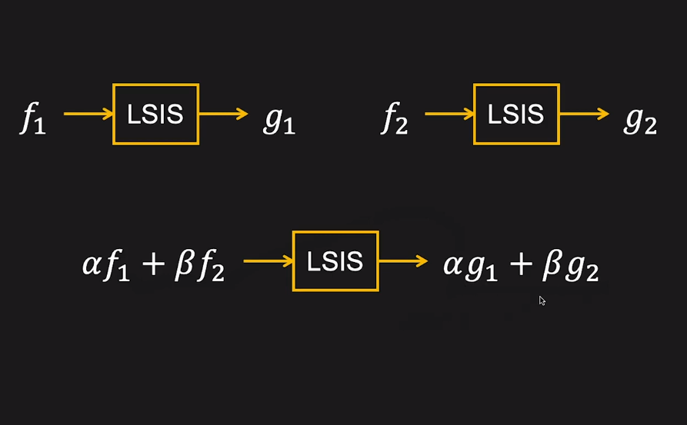
Linear Shift Invariant System

Slide 39
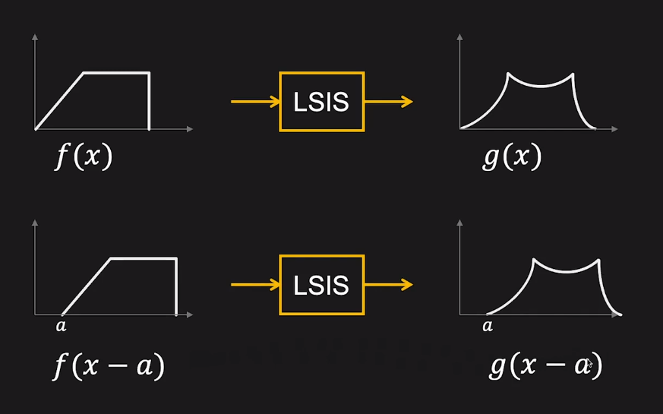
Linear Shift Invariant System

Slide 40
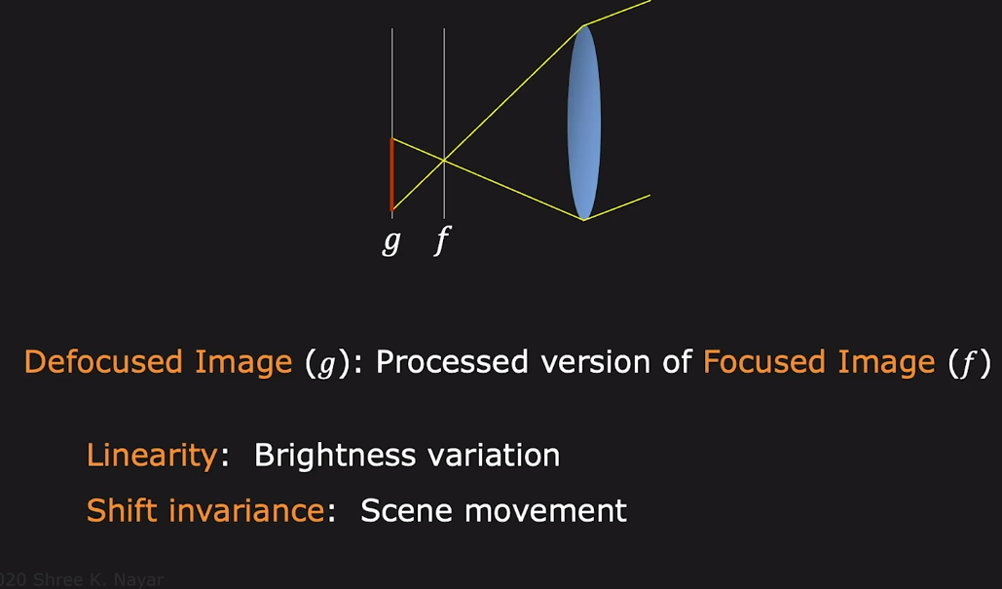
Ideal Lens as LSIS

Slide 41
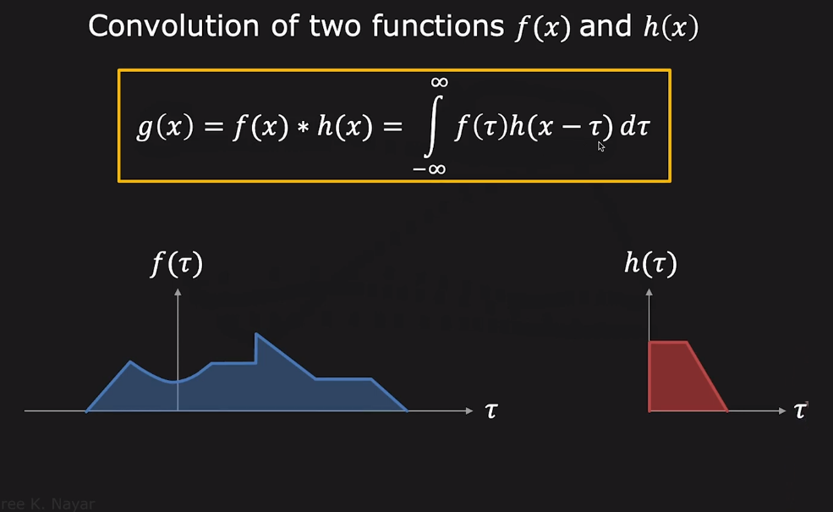
Convolution

Slide 42
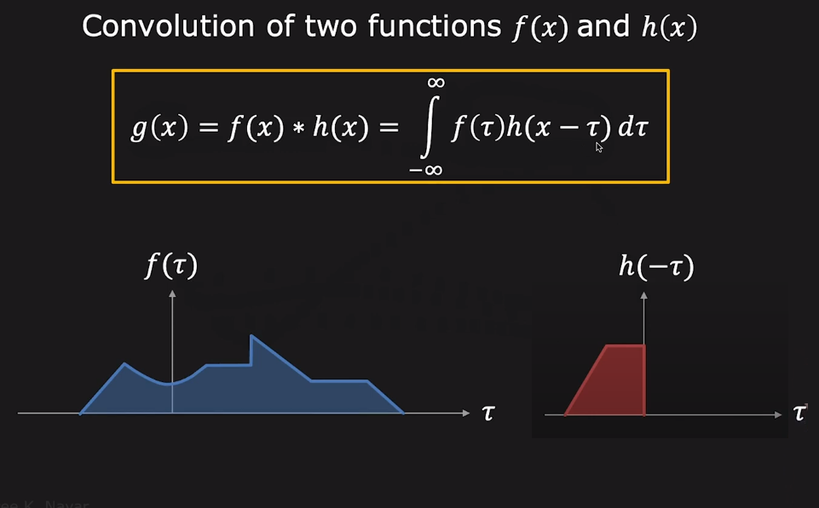
Convolution

Slide 43
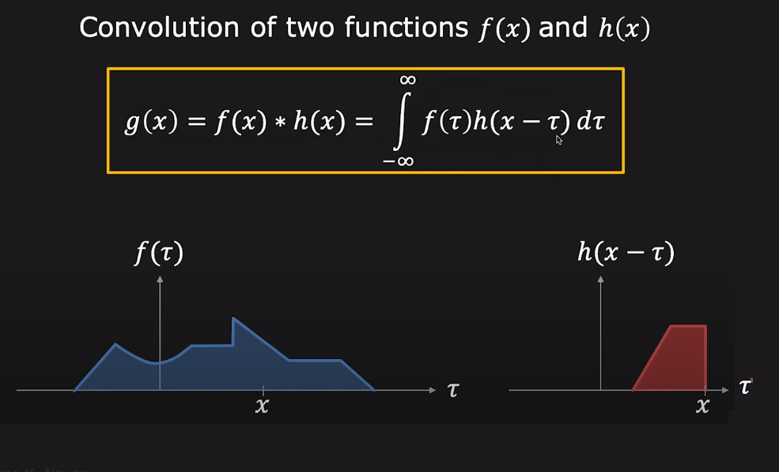
Convolution

Slide 44
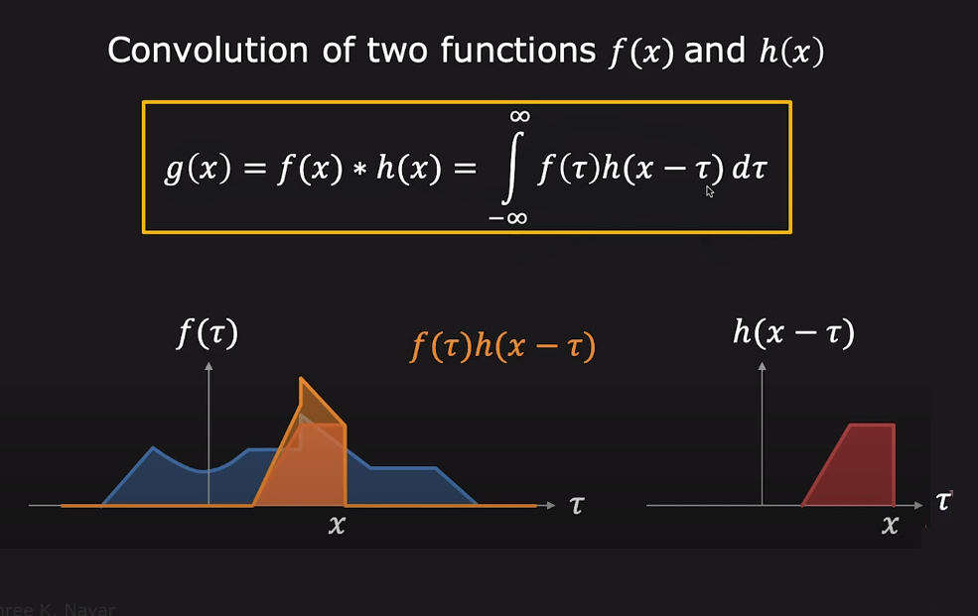
Convolution

Slide 45
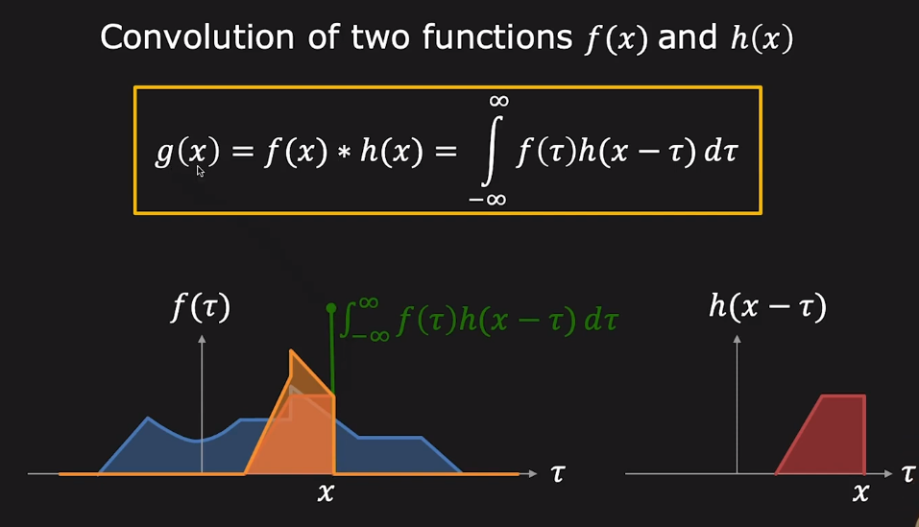
Convolution

Slide 46
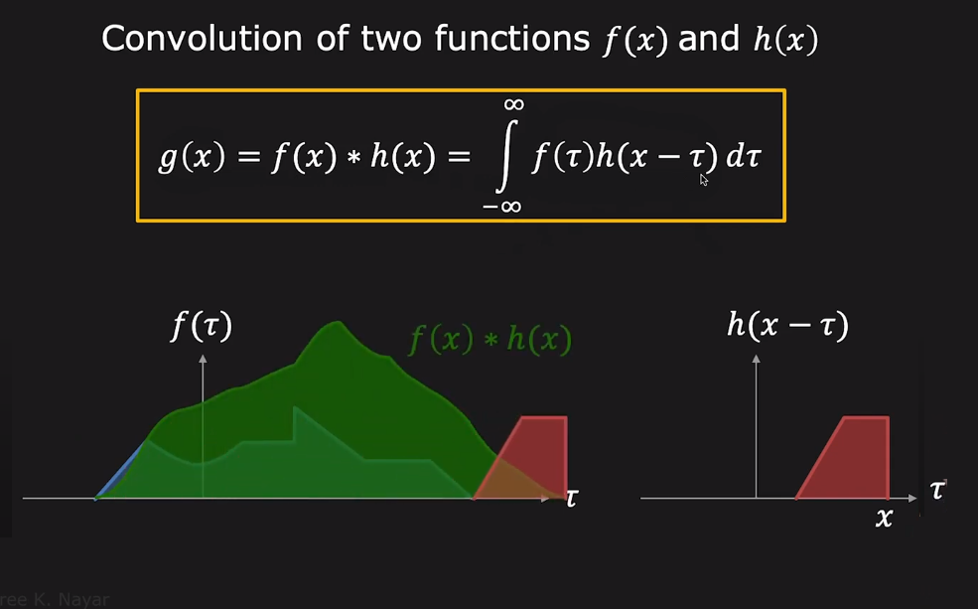
Convolution

Slide 47
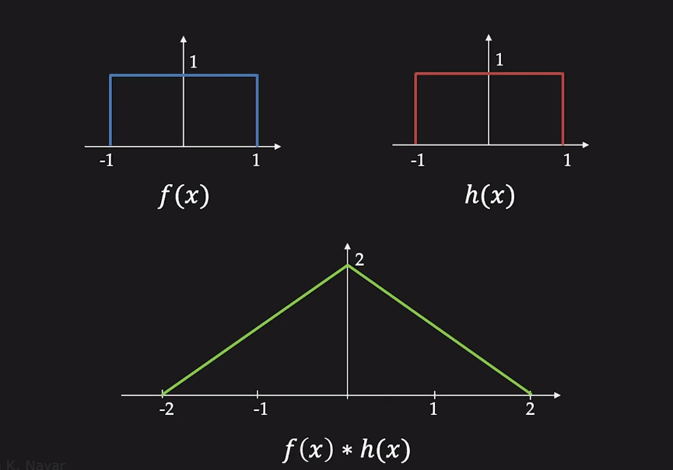
Convolution: Example

Slide 48
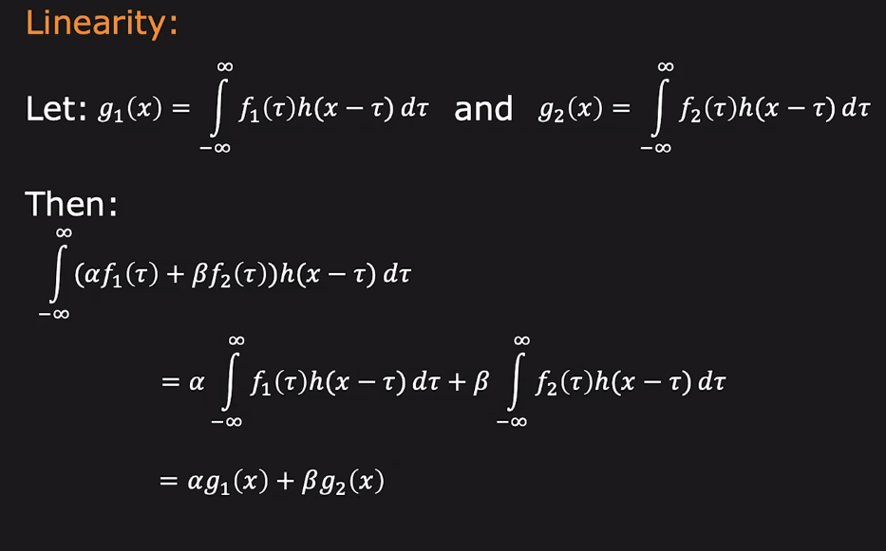
Convolution is LSIS

Slide 49
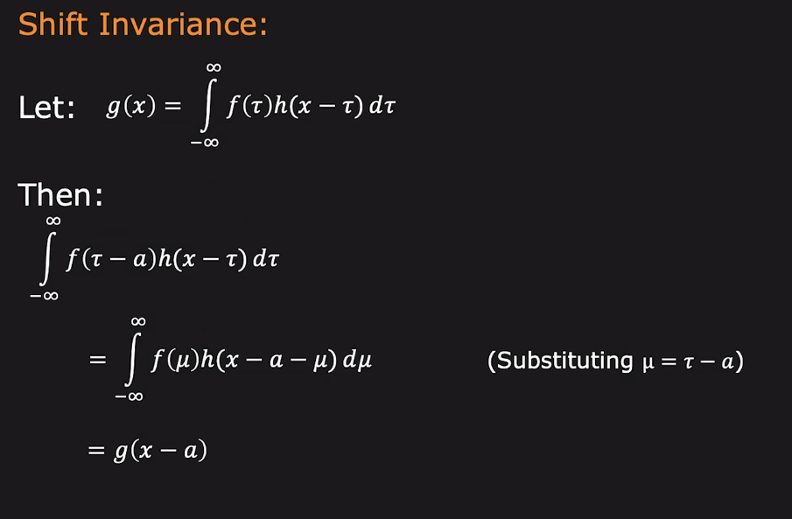
Convolution is LSIS

Slide 50
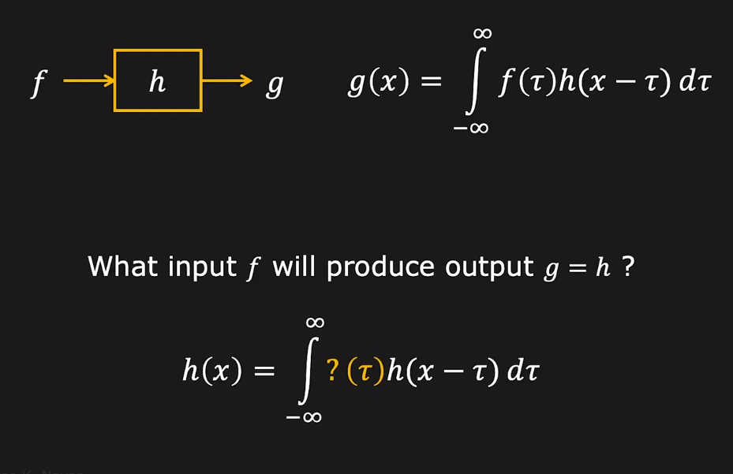
Can we find h?

Slide 51
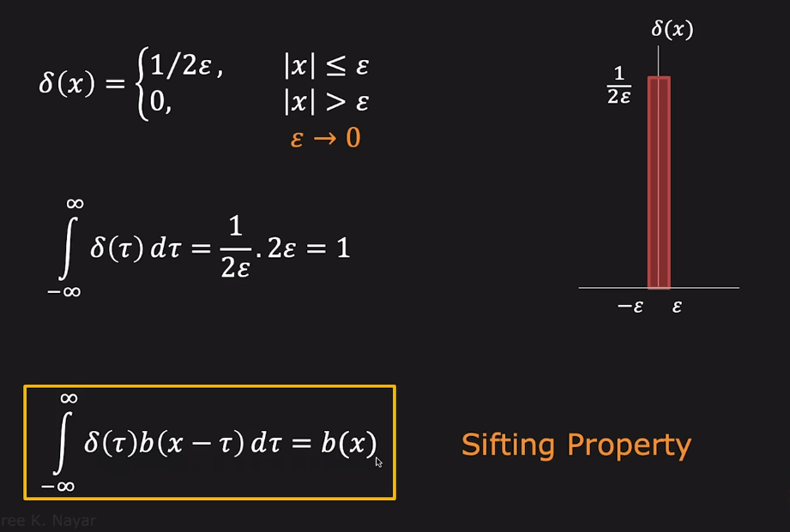
Unit Impulse Function

Slide 52
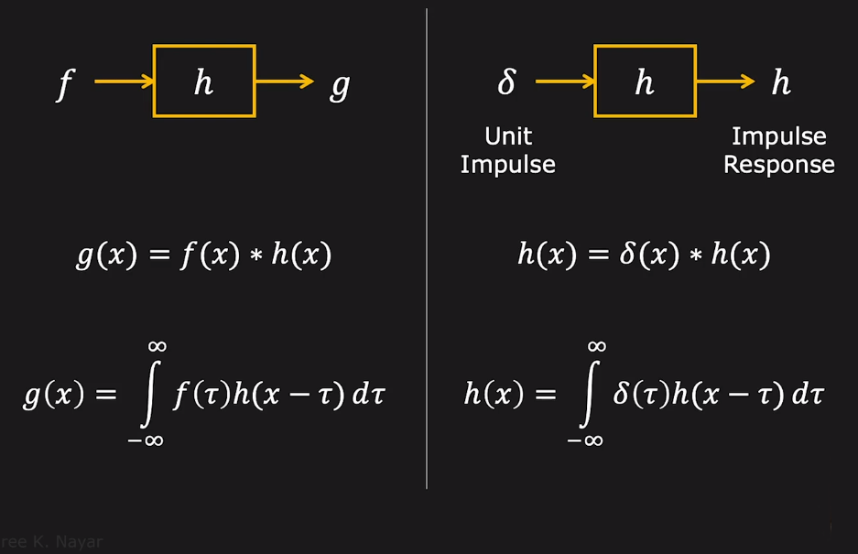
Impulse Response

Slide 53
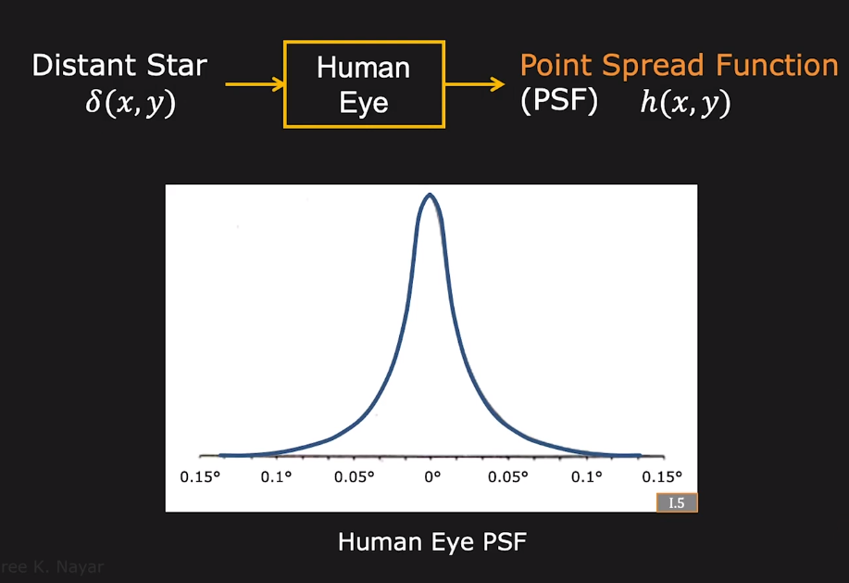
Impulse Response of Human Eye

Slide 54
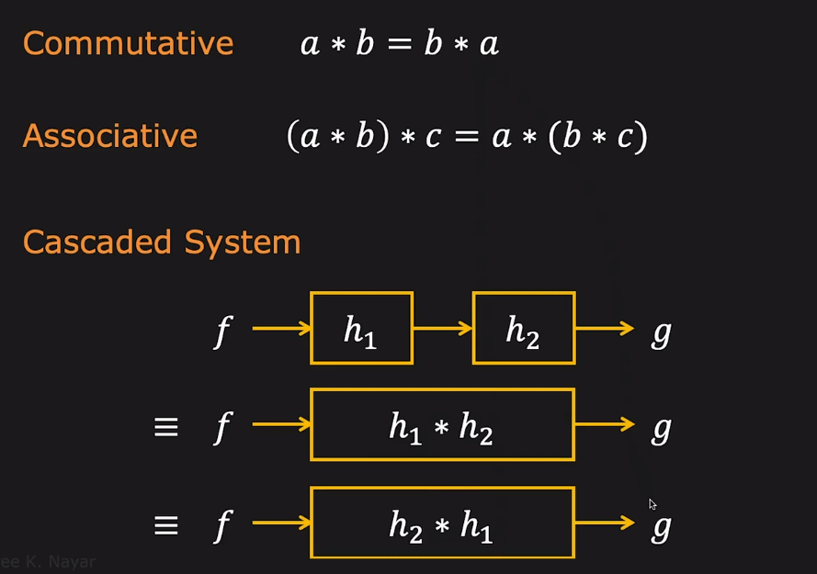
Convolution: Properties

Slide 55
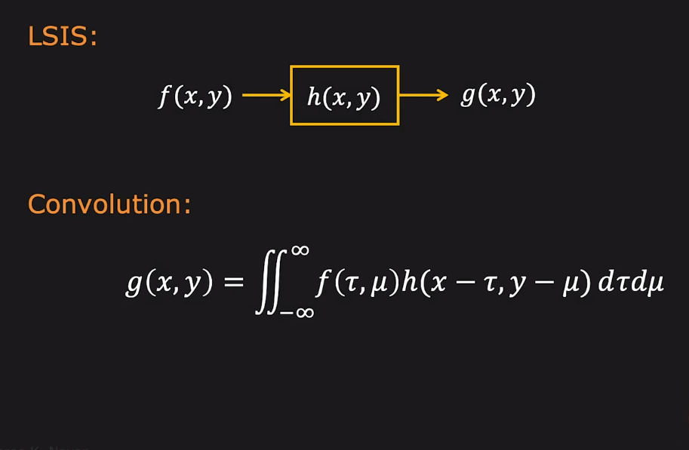
2D Convolution

Slide 56
Neighbourhood Pixel Processing
Spatial Filtering
There are two closely related concepts in spatial filtering:
1) correlation,
2) convolution
Correlation is the process of passing the mask w by the image array f.
Mechanically, convolution is the same process, except that w is rotated by 180º prior to passing it by f.
In both cases we will compute the sum of products of participating values and will place it at the desired position.

Slide 57
The Spatial Filtering Process: Correlation
Origin
x
a
b
c
r
s
t
d
e
f
X
u
v
w
g
h
i
x
y
z
Original Image Pixels
Filter
Simple 3*3 Neighbourhood
e
3*3 Filter
e_{processed} = vXe + rXa + sXb + tXc+ uXd + wXf + xXg + yXh+ zXi
y
Image f (x, y)
The above is repeated for every pixel in the original image to generate the filtered image

Slide 58
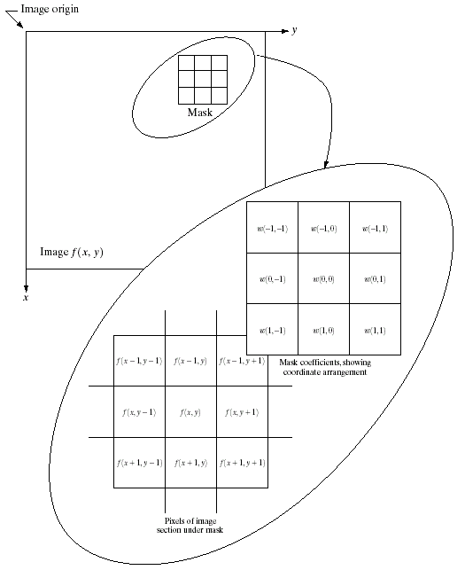
Spatial Filtering: Equation Form
Filtering can be given in equation form as shown above
Notations are based on the image shown to the left

Slide 59
A 2-D Correlation Example
Correlation of
f(x,y) with w(x,y)

Slide 60
A 2-D Correlation Example
Initial position for w
First
Pixel on
Original
f

Slide 61
‘full’ correlation result
‘same’ correlation result

Slide 62
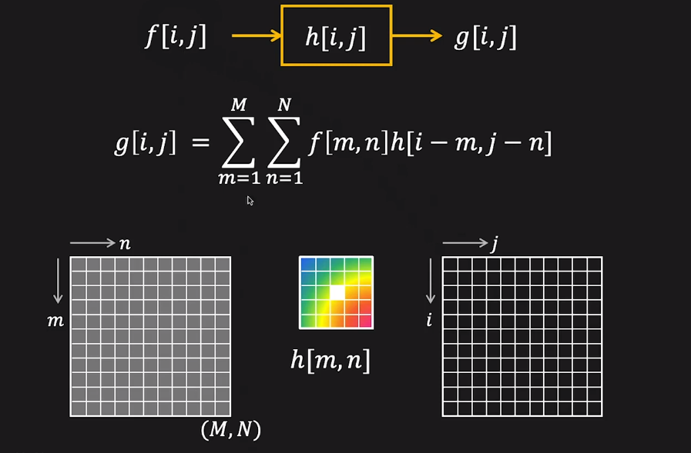
Convolution with Discrete Images

Slide 63
A 2-D Convolution Example
Initial position for w
Original:
w rotated
180º

Slide 64
‘full’ convolution result
‘same’ convolution result

Slide 65
Strange Things Happen At The Edges!
At the edges of an image we are missing pixels to form a neighbourhood
Origin
x
e
e
e
e
e
e
e
y
Image f (x, y)

Slide 66
Strange Things Happen At The Edges! (cont…)
There are a few approaches to dealing with missing edge pixels:
Omit missing pixels
Only works with some filters
Can add extra code and slow down processing
Pad the image
Typically with either all white or all black pixels
Replicate border pixels
Truncate the image
Allow pixels wrap around the image
Can cause some strange image artefacts

Slide 67
How does MATLAB do these?
g = imfilter(f , w , filtering_mode, boundary_options, size_options)
Where f is the input image, w is the filter mask, g is the filtered result, and the other parameters are summarized below.
>> f = [0 0 0 1 0 0 0 0];
>> w = [1 2 3 2 0]
>> g = imfilter(f , w , 'corr', 0, 'full')
g = 0 0 0 0 2 3 2 1 0 0 0 0
>> g = imfilter(f , w , 'corr', 0, 'same')
g = 0 0 2 3 2 1 0 0
Write the convolution version.

Slide 68
